Slide 1
ns-3 Training

Slide 2
Outline
Emulation modes
Tap Bridge
FdNetDevice
Direct Code Execution (DCE)
Applications
Linux Kernel
DCE Cradle

Slide 3
Emulation support
Support moving between simulation and testbeds or live systems
A real-time scheduler, and support for two modes of emulation
Linux is only operating system supported
Must run simulator in real time
GlobalValue::Bind (“SimulatorImplementationType”, StringValue (“ns3::RealTimeSimulatorImpl”));
Must enable checksum calculations across models
GlobalValue::Bind (“ChecksumEnabled”, BooleanValue (true));
Must run as root

Slide 4
ns-3 emulation modes
real machine
ns-3
ns-3
virtual
machine
virtual
machine
real
machine
real
machine
ns-3
Testbed
1) ns-3 interconnects real or virtual machines
2) testbeds interconnect ns-3 stacks
Various hybrids of the above are possible

Slide 5
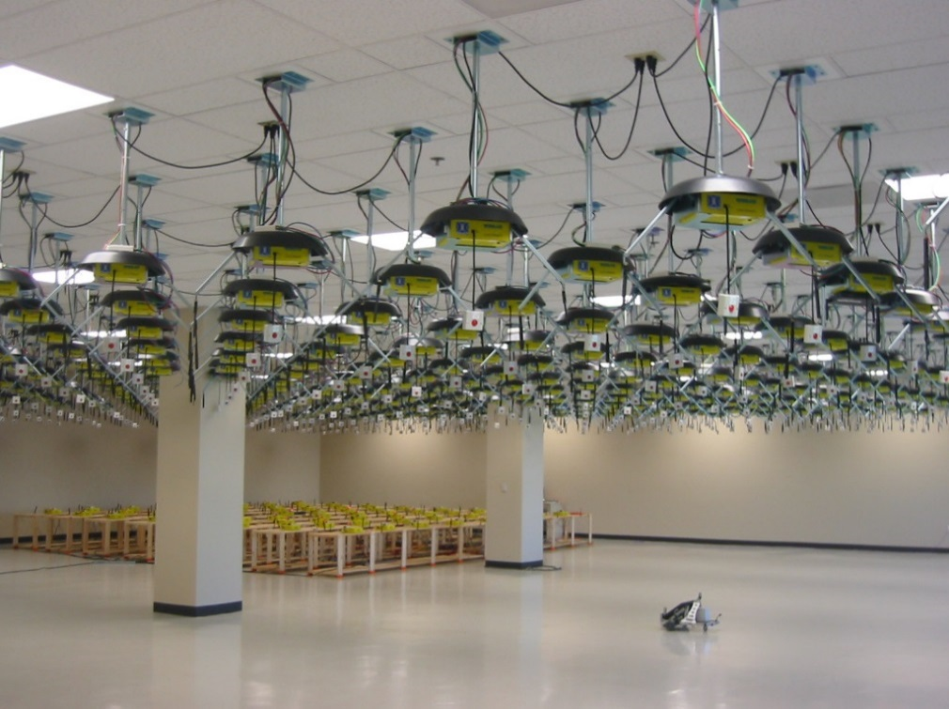
Example use case: testbeds
Support for use of Rutgers WINLAB ORBIT radio grid

Slide 6
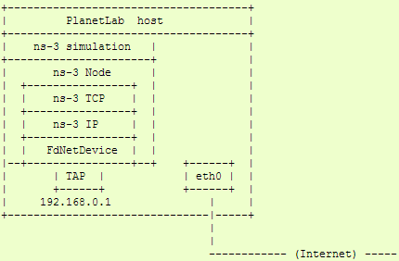
Example use case: PlanetLab
The PlanetLabFdNetDeviceHelper creates TAP devices on PlanetLab nodes using specific PlanetLab mechanisms (i.e. the vsys system), and associates the TAP device to a FdNetDevice in ns-3.

Slide 7
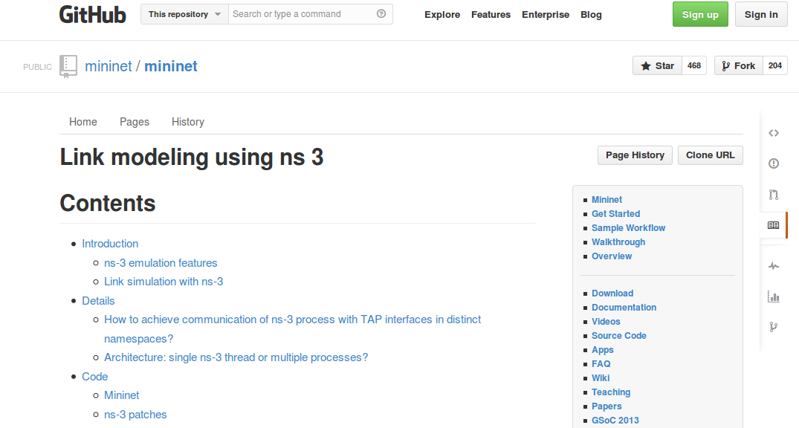
Example use case: mininet
Mininet is popular in the Software-Defined Networking (SDN) community
Mininet uses "TapBridge" integration
https://github.com/mininet/mininet/wiki/Link-modeling-using-ns-3

Slide 8
Emulation Devices

Slide 9
Device models
File Descriptor Net Device (FdNetDevice)
read and write traffic using a file descriptor provided by the user
this file descriptor can be associated to a TAP device, to a raw socket, to a user space process generating/consuming traffic, etc.
Tap Bridge
Integrate Tun/Tap devices with ns-3 devices

Slide 10
“TapBridge": netns and ns-3 integration
Linux
ns-3
Wifi
ghost node
ghost node
Container
Container
TapBridge
TapBridge
WiFi
WiFi
tapX
tapY
/dev/tunX
/dev/tunY
Tap device pushed into namespaces; no bridging needed

Slide 11
TapBridge modes
ConfigureLocal (default mode)
ns-3 configures the tap device
useful for host to ns-3 interaction
UseLocal
user has responsibility for device creation
ns-3 informed of device using “DeviceName” attribute
UseBridge
TapDevice connected to existing Linux bridge

Slide 12
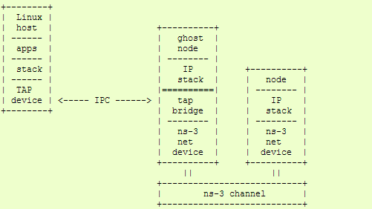
ConfigureLocal
ns-3 ensures that Mac addresses
are consistent

Slide 13
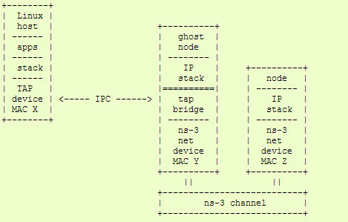
UseLocal
Mac X spoofed to Mac Y

Slide 14
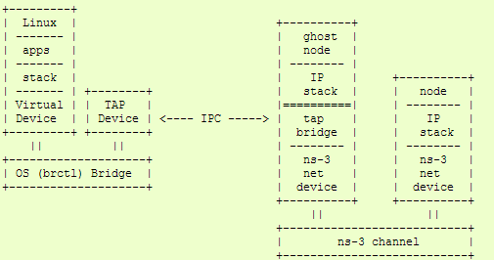
UseBridge
ns-3 devices must support SendFrom()
(i.e. bridging)

Slide 15
FdNetDevice
Unified handling of reading/writing from file descriptor
Three supported helper configurations:
EmuFdNetDeviceHelper (to associate the ns-3 device with a physical device in the host machine)
TapFdNetDeviceHelper (to associate the ns-3 device with the file descriptor from a tap device in the host machine) (not the same as TapBridge)
PlanetLabFdNetDeviceHelper (to automate the creation of tap devices in PlanetLab nodes, enabling ns-3 simulations that can send and receive traffic though the Internet using PlanetLab resource.

Slide 16
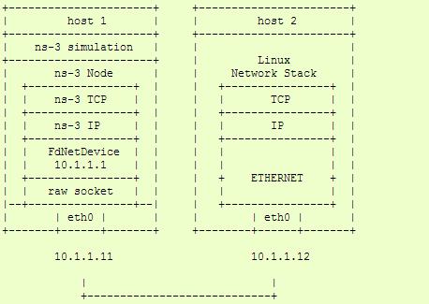
EmuFdNetDeviceHelper
Device performs MAC spoofing to separate emulation from host traffic

Slide 17
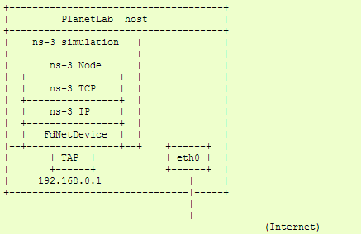
PlanetLabFdNetDeviceHelper
Special case of TapFdNetDeviceHelper where Tap devices configured according to PlanetLab conventions

Slide 18
ns-3 over host sockets
Two publications about how to run ns-3 applications over real hosts and sockets
"Simulator-agnostic ns-3 Applications", Abraham and Riley, WNS3 2012
Gustavo Carneiro, Helder Fontes, Manuel Ricardo, "Fast prototyping of network protocols through ns-3 simulation model reuse", Simulation Modelling Practice and Theory (SIMPAT), vol. 19, pp. 2063–2075, 2011.

Slide 19
Generic Emulation Issues
Ease of use
Configuration management and coherence
Information coordination (two sets of state)
e.g. IP/MAC address coordination
Output data exists in two domains
Debugging can be more challenging
Error-free operation (avoidance of misuse)
Synchronization, information sharing, exception handling
Checkpoints for execution bring-up
Inoperative commands within an execution domain
Deal with run-time errors
Soft performance degradation (CPU) and time discontinuities

